Slide 1
Introduction to OSS - Azure
Abdul Rasheed Feroz Khan

Slide 2
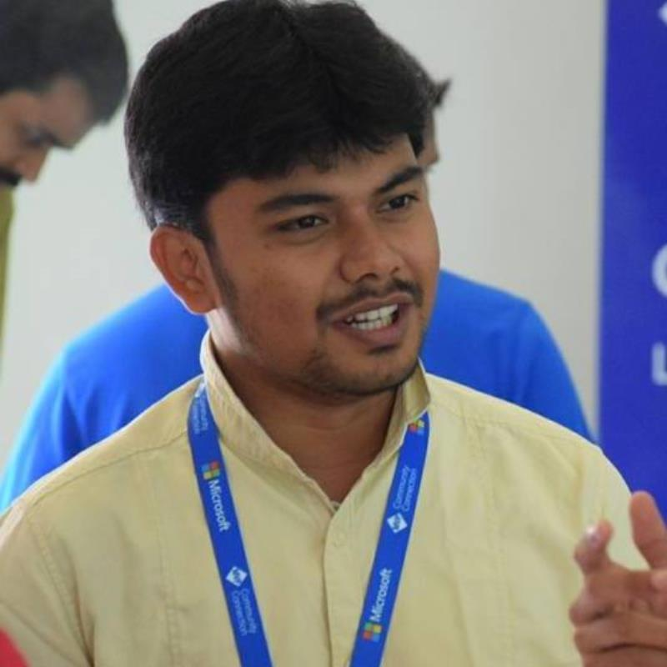
About the Instructor
Microsoft Most Valuable Professional – Azure
C# Corner Most Valuable Professional
Microsoft Certified Trainer
7 Years of experience as Cloud Consultant
Azure – AWS – GCP – IoT – Machine Learning – Cognitive Services – Bot – Xamarin – Big Data
Consultant for Accenture, Adobe, Boeing, Deloitte., Infosys, Johnson Controls, Microsoft, Wipro, etc.,

Slide 3

Open Source on Microsoft Azure
Compute
IaaS
PaaS
Mobile Services
Data
SQL
NoSQL
Big Data Analytics

Slide 4
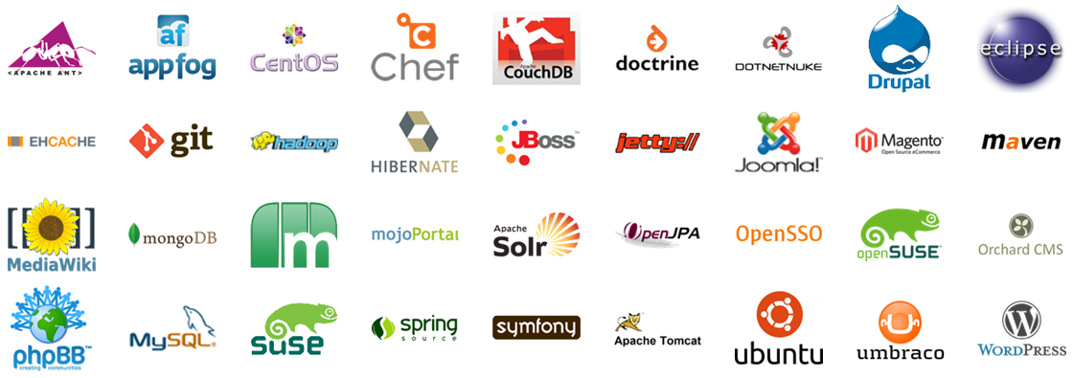
Open Source on Azure
Notes:
Microsoft’s commitment to openness and collaboration is ingrained in our day-to-day approach to doing business with partners around the world.

Slide 5
Compute: IaaS, PaaS & Mobile Services

Slide 6
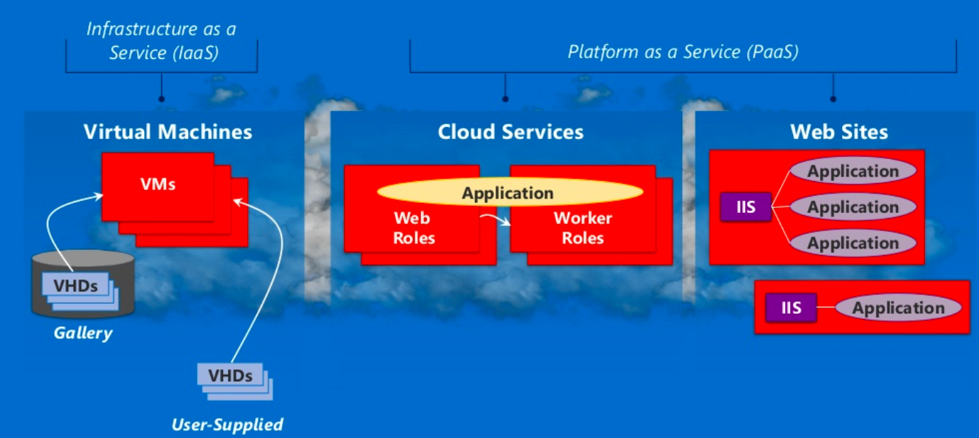
Azure Compute:

Slide 7
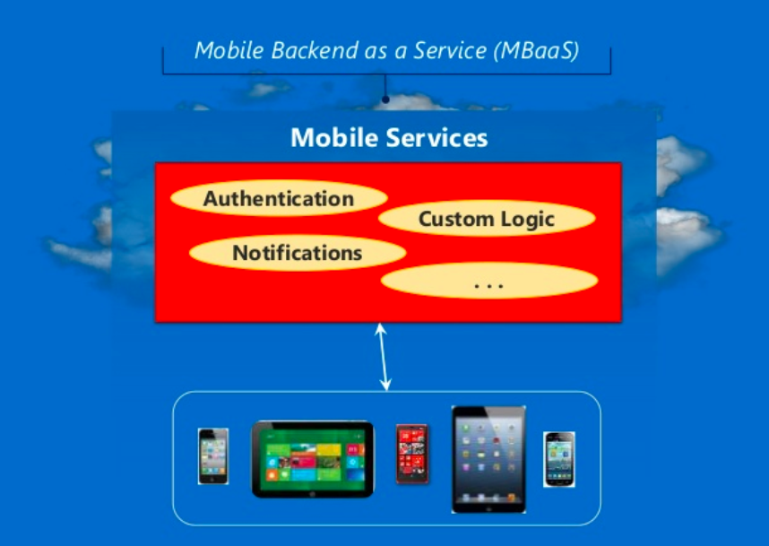
Azure Compute:

Slide 8
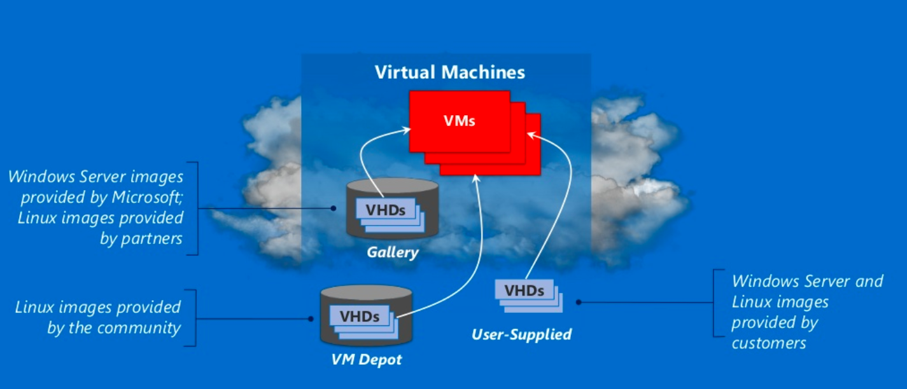
Azure Compute : IaaS

Slide 9
Linux Images:
Canonical UBUNTU
Oracle Linux
SUSE Linux Enterprise
OpenSUSE Linux
CENTOS by Open Logic
Notes:
Microsoft provides forum based support for all open source platforms today
Canonical Ubuntu – also available with pre-installed puppet enterprise from puppet labs.

Slide 10
Management with Puppet and Chef
Windows VM's
Linux VM's
Puppet Console
Chef Management Console

Slide 11
Linux images on Azure
Linux distributions
Images also includes other software
Notes:
The Linux images in the gallery just provides the OS
Linux distributions on other platforms like Debian are also available on azure.
Images also includes other softwares like wordpress

Slide 12
Pricing Comparison
Windows Server
Linux Server
Small A1 (1 Core, 1.75 GB) | $0.09 per hour
Medium A2 (2 Cores, 3.5 GB) | $0.18 per hour
Large A3 (4 Cores, 7 GB) | $0.36 per hour
Extra Large A4 (8 Cores, 14 GB) | $0.72 per hour
Memory Intensive A5 (2 Cores, 14 GB) | $0.33 per hour
Memory Intensive A6 (4 Cores, 28 GB) | $0.66 per hour
Memory Intensive A7 (8 Cores, 56 GB) | $1.32 per hour
Small A1 (1 Core, 1.75 GB) | $0.06 per hour
Medium A2 (2 Cores, 3.5 GB) | $0.12 per hour
Large A3 (4 Cores, 7 GB) | $0.24 per hour
Extra Large A4 (8 Cores, 14 GB) | $0.48 per hour
Memory Intensive A5 (2 Cores, 14 GB) | $0.25 per hour
Memory Intensive A6 (4 Cores, 28 GB) | $0.50 per hour
Memory Intensive A7 (8 Cores, 56 GB) | $1.00 per hour
Notes:
Standard pay as you go pricing
Linux is as much as 1/3 cheaper than windows server

Slide 13
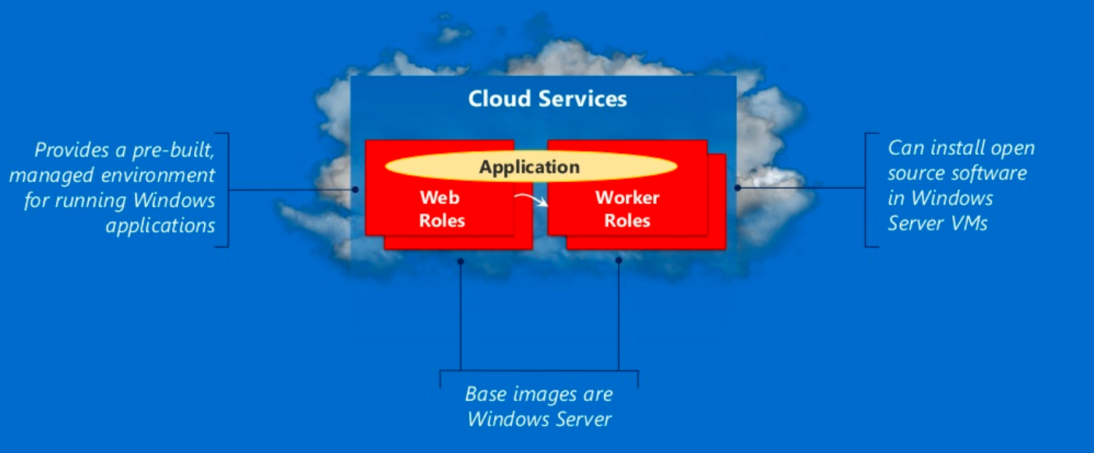
Azure Compute : PaaS

Slide 14
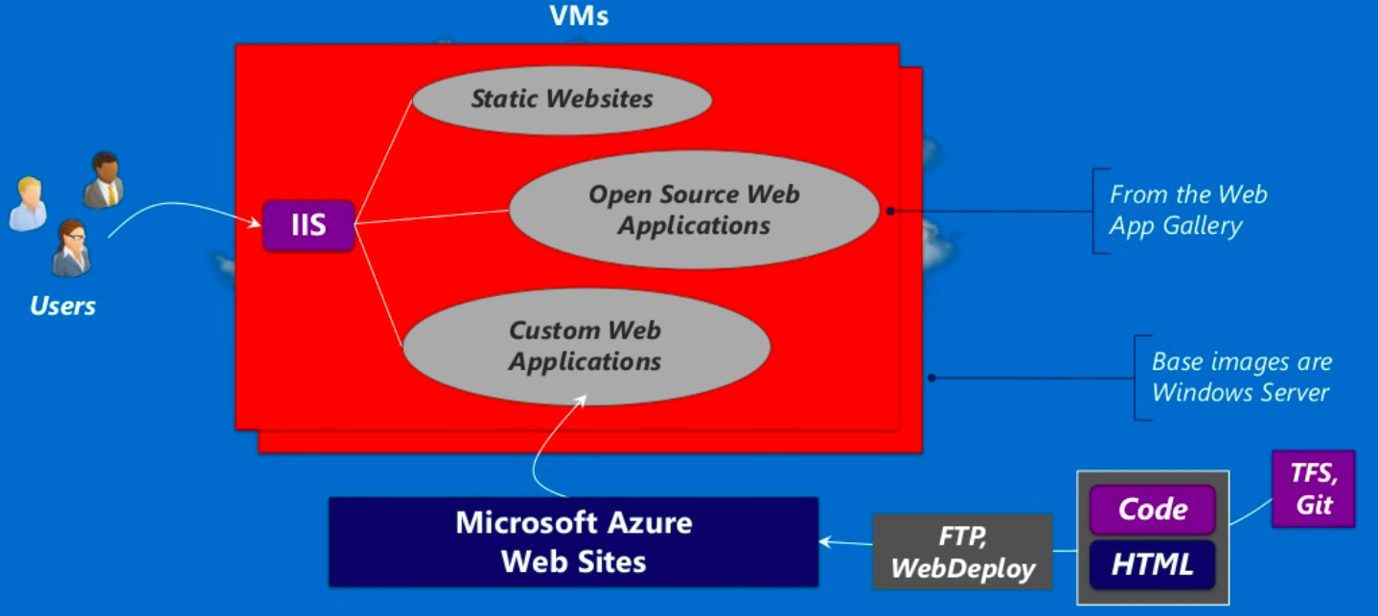
Azure Compute – PaaS - WebApps

Slide 15



Azure Web Sites:
Applications | What it provides | Technology Foundation
Wordpress | Content Management System and Blogging | PHP/MySQL
Joomla | Content Management System | PHP/MySQL (and others)
Media Wiki | Wiki package | PHP/MySQL (and others)
Apache Tomcat | Web Server (or) Servlet Container | Java
Express | Web Framework | Javascript / Node.js

Slide 16


Supported Open Source Web Developments
Node.js
.
.
Notes:
PHP – Scripting language and environment for web development
Node.js - environment for web development with javascript
Python – general purpose dynamic programming language.
Note - .net and java applications are also supported.

Slide 17
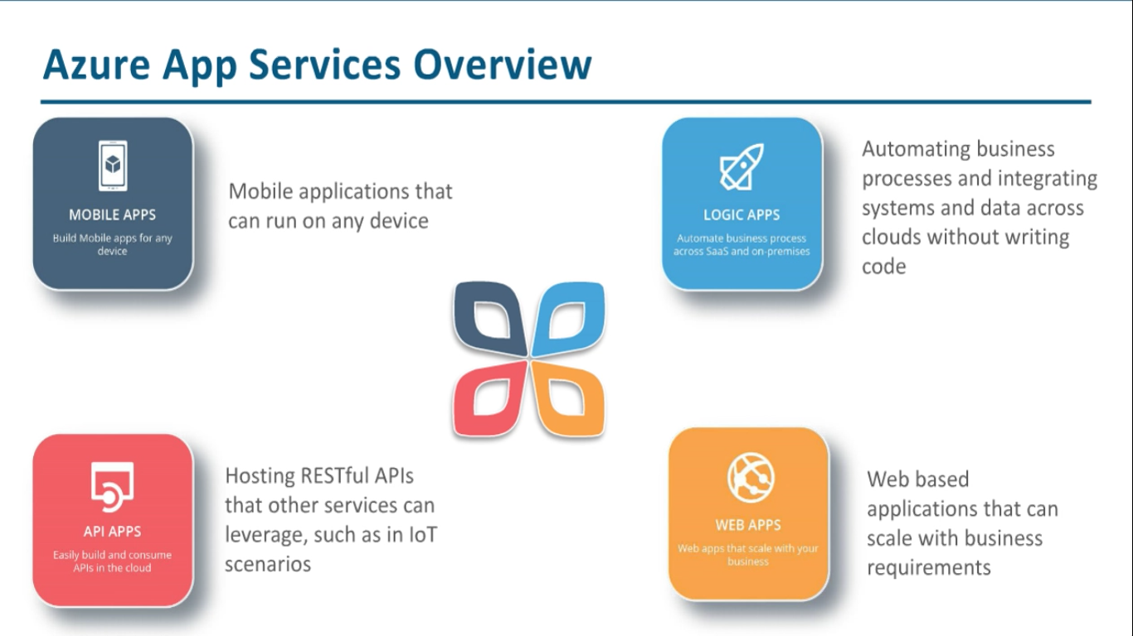

Slide 18
Data
SQL
NoSQL
Big Data Analytics

Slide 19
Azure with Open Source:
 | Operational Data | Analytical Data
NoSQL Technologies | Tables, Redis Cache Cassandra, HBase, etc., MongoDB Neo4J, etc., | Big Data Analytics – HDInsight, Hadoop
SQL Technologies | SQL Database, SQL Server, Oracle, MySQL, etc., | Relational Reporting & Relational Analytics
Notes:
Provided by Microsoft Azure – Runs in MS Azure VM's – Runs in MS Azure Virtual Machines and its open source

Slide 20
Operational NoSQL Databases
Example Technologies | What it provides?? | Example Use Cases
Redis – Azure Tables | Fast access to large amounts of simply structured data | Online shopping cart
Cassandra, HBase | Fast access to large amounts of more structured data | A table storing web pages
MongoDB | Scalable store for JSON documents | Persistent store for Node.js application
Notes:
Provided by Microsoft Azure – Runs in MS Azure VM's – Runs in MS Azure Virtual Machines and its open source

Slide 21
Microsoft Azure Success Story with Openness

Slide 22


Slide 23
Join us to explore more!!!

